Slide 1

BCrypty: Secure Swap Blockchain Bridge
Supervisor: M. Kamran Abid
Presented by:
Rayyan Waseem (2K20-BSCS-202)
Muhammad Abdullah (2K20-BSCS-236)
Department of Computer Science, NFC institute of Engineering and Technology, Multan

Slide 2

Outline
Introduction
Background
Problem statement
Proposed solution
Use case
Activity Diagram
Sequence Diagram
Function and non-functional requirements
Novelty
Interface
Testing
Implementation

Slide 3
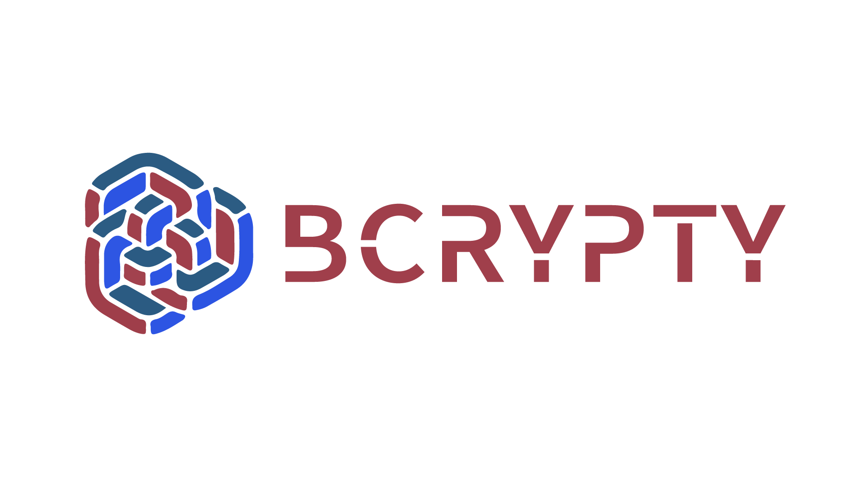

Introduction
Financial transactions are often assumed to be simple, but creating a reliable platform for such services requires meticulous effort. As users become more discerning about the services they trust with their financial assets, the need for efficient and secure money transfer solutions has become more pronounced, especially during the Covid-19 pandemic.
BCrypty introduces a revolutionary platform: a Trusted Peer-to-Peer Blockchain-Based D-App accessible via web. Amidst a demand for seamless and reliable money transfers, BCrypty stands out as the premier solution for secure and swift transactions.

Slide 4




Background
Competitors:

Slide 5

Shortcomings
High Gas Fees on Ethereum Blockchain
Regulatory Uncertainty in Token Classification
Centralization Risks in Governance and Token Distribution
Security Vulnerabilities in Smart Contracts and Protocols

Slide 6

Our Solution
BCrypty introduces a revolutionary platform: a Trusted Peer-to-Peer Blockchain-Based system enabling swift and secure money transfers
Swift and Secure Money Transfers.
No KYC.
Decentralized Governance.
Low Fees.

Slide 7

Problem statement
Impediments to DeFi and Blockchain Advancement
The growth of decentralized finance (DeFi) platforms and blockchain apps is facing several big problems. High gas fees on the Ethereum blockchain make transactions expensive and hard for people to afford. Unclear regulations about how tokens are classified slow down innovation on these platforms. Centralized control in governance and token distribution threatens the goal of decentralization. Also, security issues in smart contracts put users' money at risk, making it hard for people to trust DeFi systems.

Slide 8

Proposed solution
Foster financial inclusion through decentralized finance (De-Fi) solutions.
Ensure trust and transparency in financial transactions using blockchain technology.
Reduce transaction costs by leveraging decentralized networks.
Drive innovation in finance by merging De-Fi, and Decentralized Governance.

Slide 9

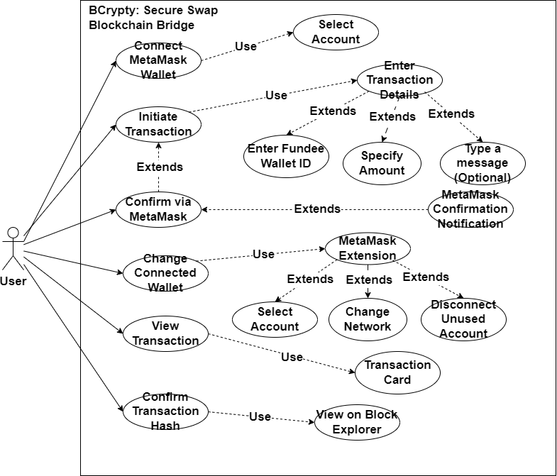
Use case

Slide 10

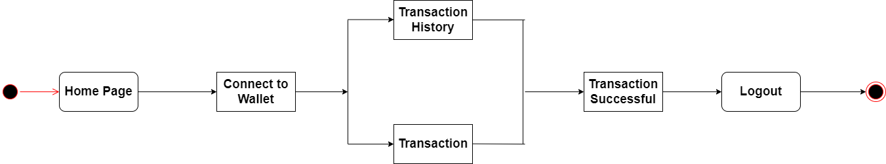
Activity diagram

Slide 11
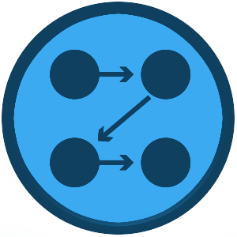
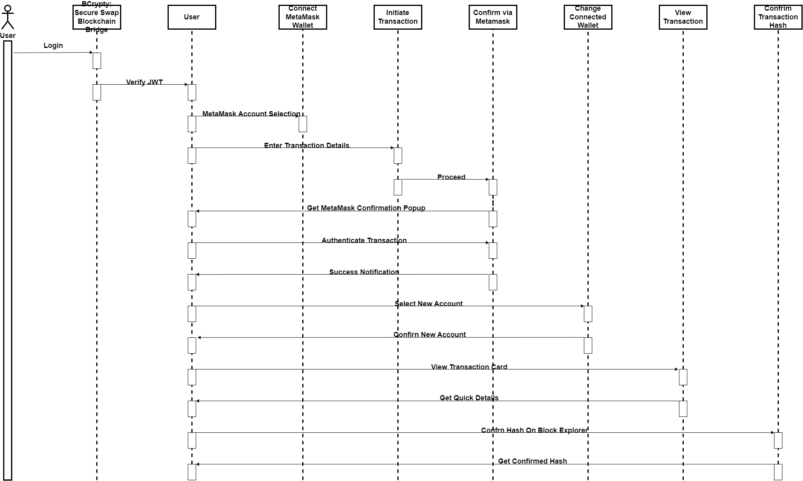
Sequence diagram

Slide 12

Function and Non-functional requirements
Function Requirements | Non-functional requirements
Allow Connection to MetaMask | Performance
No KYC Policy | Reliability
Security of User Data and Transactions | Security
Monitor Transaction History | Accessibility

Slide 13


Novelty
Decentralized Transactions
Transparent Ledger
Low Transaction Fees
Enhanced Security
Global Accessibility
No KYC

Slide 14
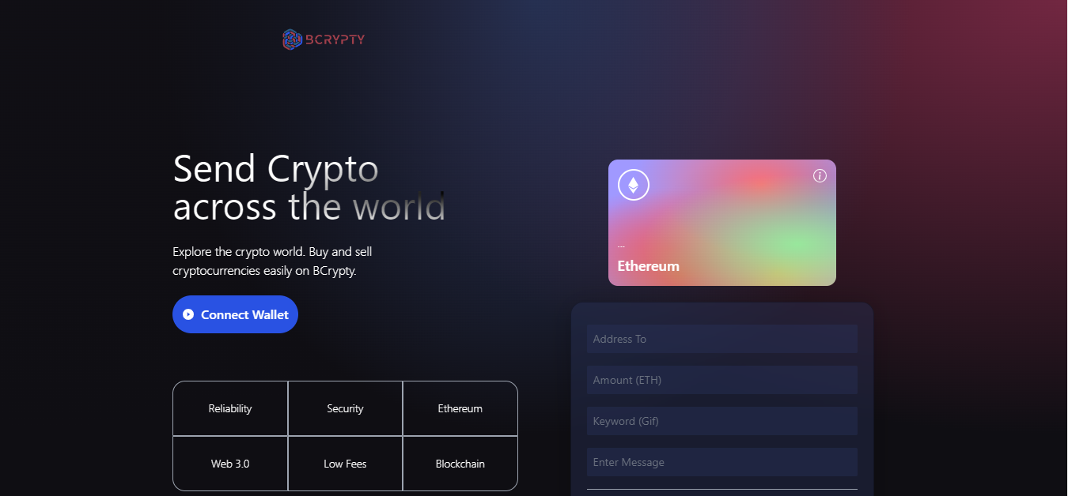
Interface
Homepage

Slide 15
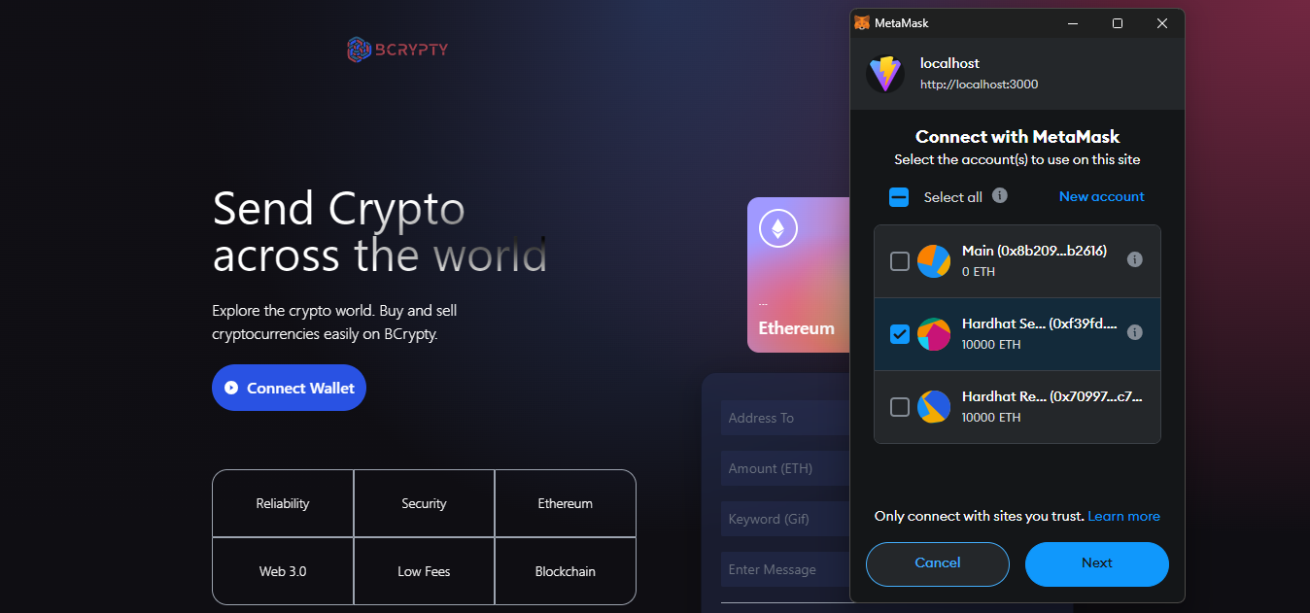
Interface
Wallet Connection

Slide 16
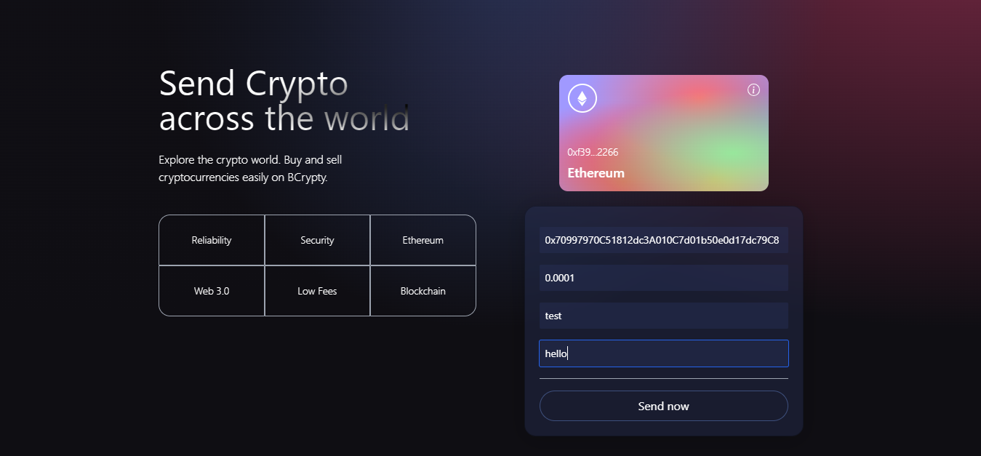
Interface
Initiate Transaction

Slide 17
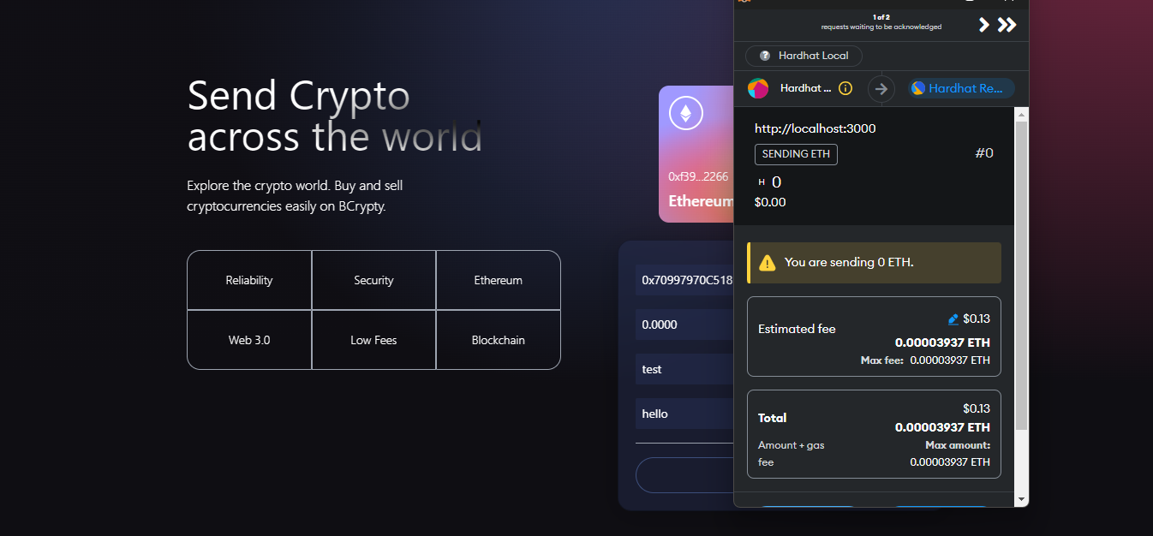
Interface
Verify Transaction

Slide 18
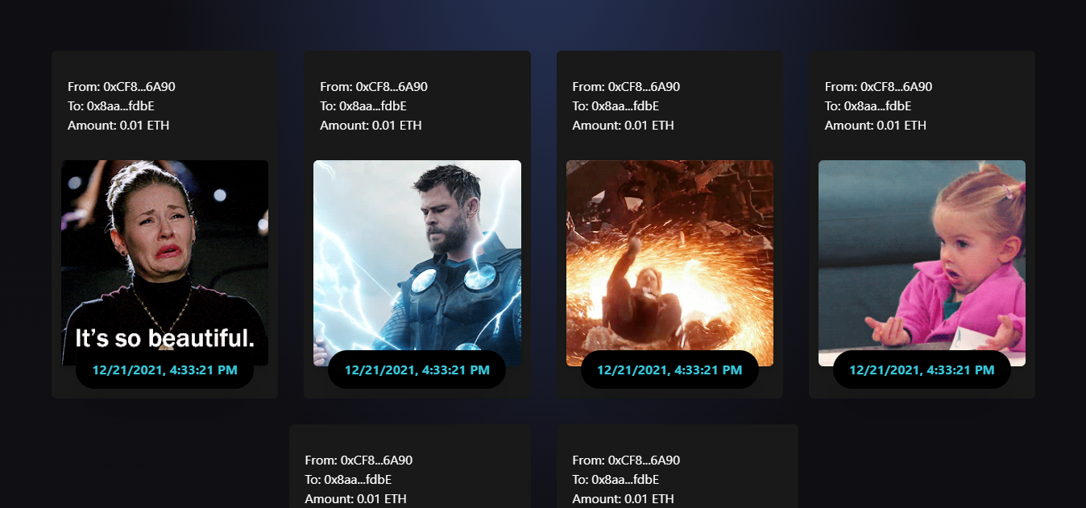
Interface
Transaction History Section

Slide 19

Testing
Software testing is a critical process in the software development life cycle, essential for evaluating and verifying the functionality, performance, security, and other aspects of a software application. It identifies defects, errors, and vulnerabilities, ensuring reliability, robustness, and high quality. Early detection and fixing of issues reduce costly and time-consuming fixes later in the development process.

Slide 20

Testing
Unit Testing
Integration Testing
System Testing
Performance Testing
Security Testing
Regression Testing

Slide 21

Testing
Black-box Testing (behavioral):
The main objective of black-box testing is to validate the software's functionality, usability, and compatibility with the expected requirements, without being influenced by the internal implementation.
White-box Testing (structural):
White-box testing, also known as structural testing or glass-box testing, is a software testing technique that focuses on testing the internal structure and implementation details of the software system.

Slide 22

Test Cases
Test Case ID: BC-TC001
Test Case Title: Connect MetaMask Wallet Account
Test Objective: To verify if a user can connect MetaMask Wallet using the BCrypty app.
Test Steps:
Launch the BCrypty app.
Navigate to the "Connect Wallet" Button and click it.
Choose a wallet account to connect to App and click connect
Verify if the account is connected properly.
Verify if the account address shows in the wallet card.
Logout from the app.
Expected Result:
The MetaMask wallet is successfully connected to the BCrypty app.
The user's wallet address is displayed in the wallet card, indicating a successful connection.
Upon logging out from the app and logging back in, the connected MetaMask wallet remains connected without any issues.
No changes or disruptions occur in the user's connected MetaMask wallet due to the connection with the BCrypty app.
The user can seamlessly initiate and receive cryptocurrency transactions using the connected MetaMask wallet within the BCrypty app.

Slide 23
Test Cases
Test Case ID: BC-TC002
Test Case Title: Verify funds transfer to other account
Test Objective: To verify if the system correctly handles funds Transfer to another account,
Test Steps:
Launch the BCrypty app.
Log in with valid credentials.
Navigate to the "Transfer Funds" feature.
Enter the recipient's wallet address and the amount to be transferred.
Click on the "Transfer" button to initiate the transfer.
Verify if a confirmation popup from MetaMask appears, asking the user to confirm the transaction.
Confirm the transaction in MetaMask.
Verify if a confirmation message is displayed within the BCrypty app, confirming the successful transfer.
Logout from the app.
Test Data:
Recipient's wallet address: [0x7019d3Cc0a363c30d0D31bF55cC6351c78f09A50]
Amount to be transferred: [0.0001 ETH]
Expected Result:
A confirmation popup from MetaMask appears, asking the user to confirm the transaction.
The transferred amount is reflected in the recipient's account balance.

Slide 24

Implementation
Project Planning:
Define project scope, objectives, and requirements. Create a project timeline and allocate resources.
Technology Selection:
Choose appropriate technologies, frameworks, and databases for development.
System Design:
Create a detailed system design, including app architecture, components, and user interfaces.
Blockchain Integration:
Integrate blockchain technology for crowdfunding transactions and smart contracts.
Security Implementation:
Implement security measures to protect against common vulnerabilities.

Slide 25


